Slide 1


TRENDS IN PARASITIC COPEPOD
INFECTION
AMONG JUVENILE SALMONIDS
IN WVP RESERVOIRS
Principal Investigators:
Fred R. Monzyk
Jeremy D. Romer
Ryan Emig
Thomas A. Friesen
Oregon Department of Fish and Wildlife
Corvallis Research Lab
Corvallis, Oregon
Notes:
First part of presentation will be a summary of copepod infection levels we observed over the last few years
Second part will be discussion of possible cause and solutions.

Slide 2
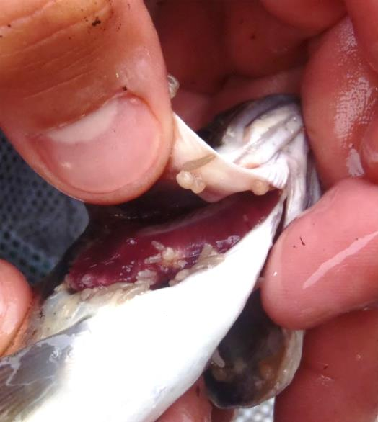
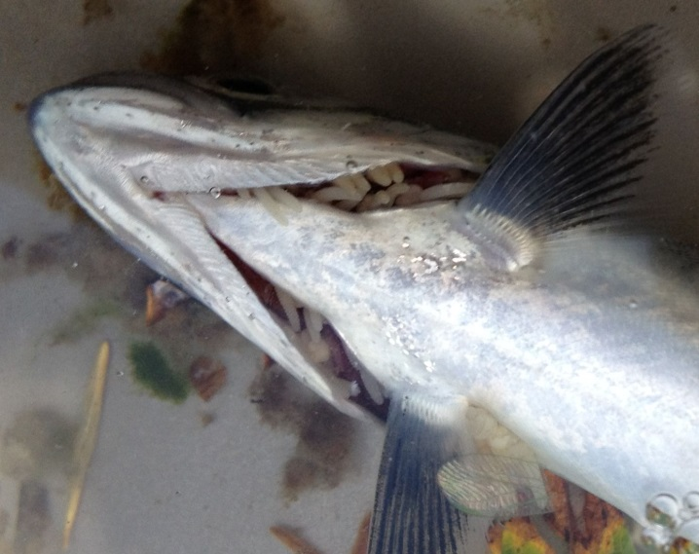
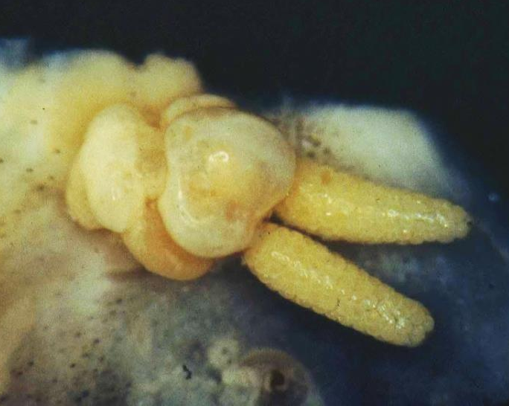
Background
Salmincola californiensis only infect Oncorhynchus spp.
Endemic to PNW freshwater habitats
Can cause physical damage to gill structure/mortality
Incidence of infection tends to increase with fish size
Life Cycle
Eggs
Copepodid
Chalimus stages (1-4)
Adult ♀
28-32 d
to hatch
Infectous free-
swimming stage
(live for ~2 d)
Re-attaches to tissue
(4 -14 d)
Can produce
2 broods

Slide 3
Objectives
Compare infection levels between stream-rearing and
reservoir-rearing Chinook
Compare susceptibility to parasitic copepods among
Oncorhynchus species in reservoirs
Evaluate changes in infection through time
  Prevalence and Intensity on gills

Slide 4
Methods
All fish collected were examined macroscopically for
♀ copepods on gills and fins
    Counted copepods on subsample of fish
Screw traps, gill nets, electrofishing, seining
    Detroit, Foster, Cougar, Lookout Point,
    and Fall Creek (USACE)

Slide 5
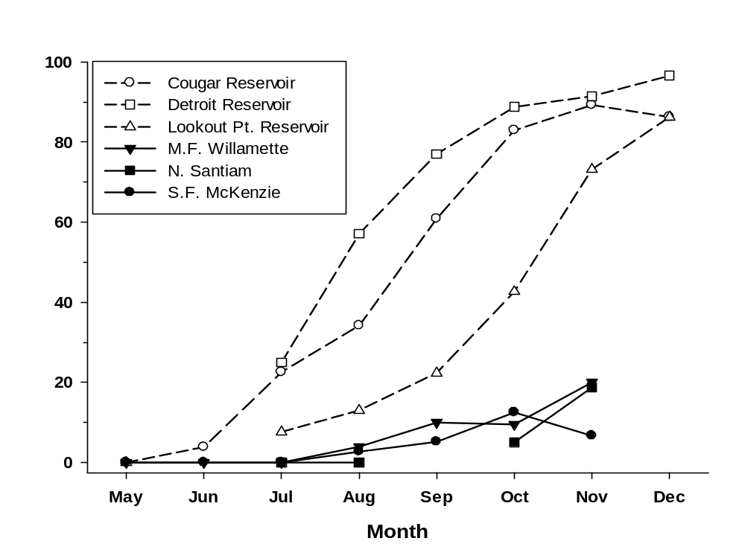
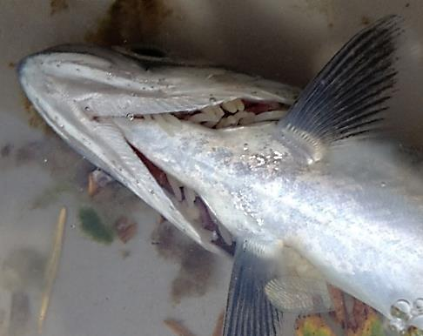
Results
Infection Prevalence much greater in reservoirs compared to streams
Subyearling Chinook
2012-2013
Attached to gills
Reservoirs: 80%
Streams: 19%

Slide 6
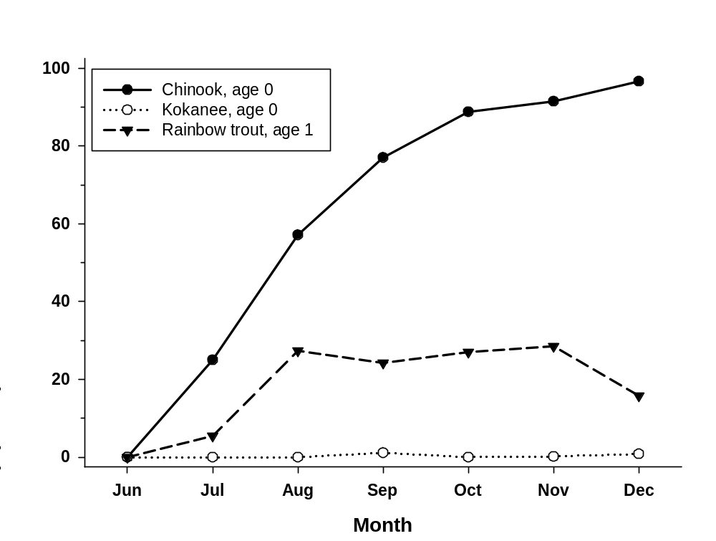
Results
Chinook are more vulnerable to infection
  Factors could be habitat, behavioral (feeding, schooling), or evolutionary (immunity)
Detroit
2012-2013
96%
28%
1%

Slide 7
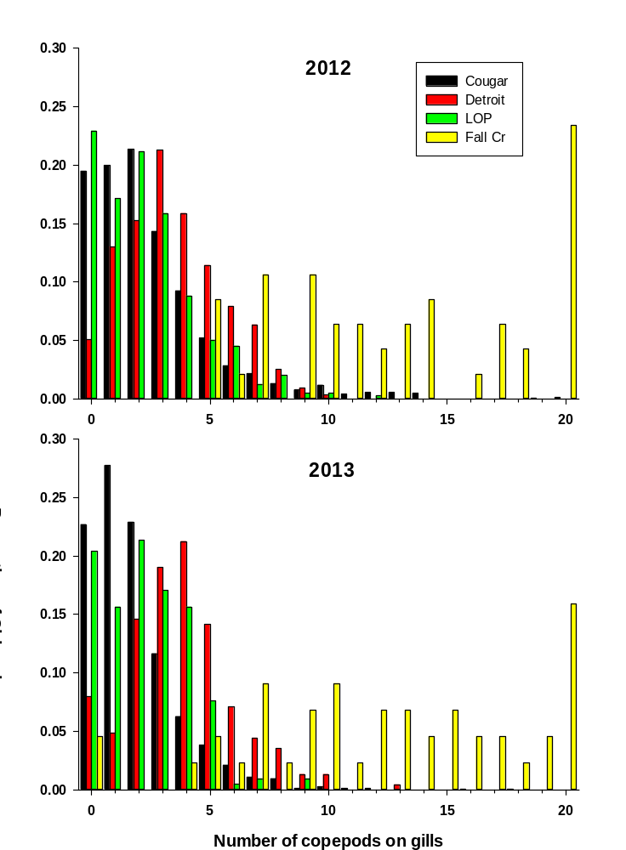
Results
Subyearling Chinook in Nov-Dec
16-24% of Fall Creek
Chinook >20 copepods
85% mortality
during saltwater
transition
(Pawaputanon 1980)
+
+

Slide 8
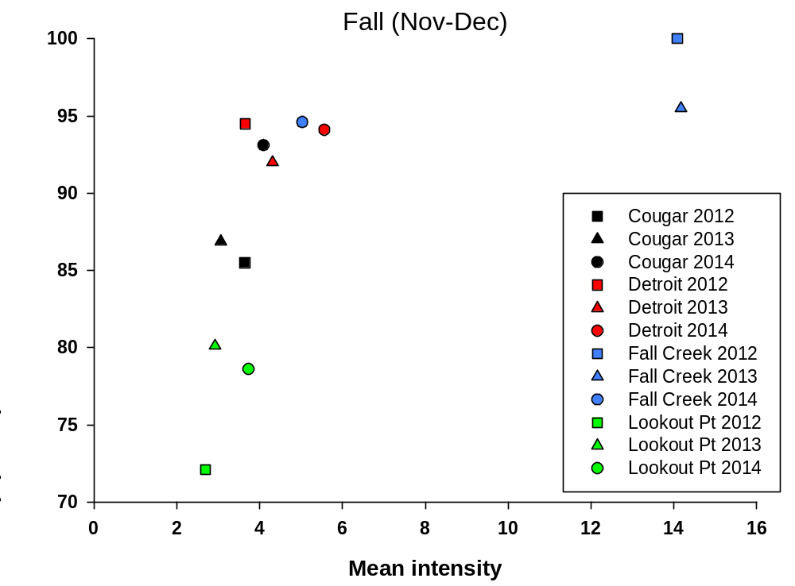
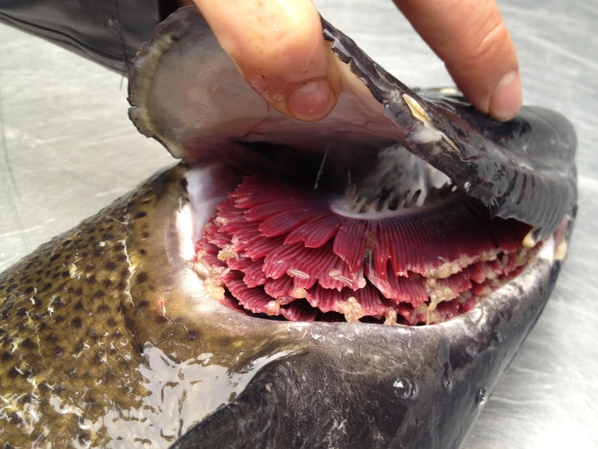
Results
Late arriving adults
released @ Gold Creek
Infected adults
Fall Creek
Steelhead and Chinook
adults (Mar-Sep)
Released near or in reservoir
Lookout Point
Chinook release >30km above reservoir
Lower infection levels in Lookout Point
Higher infection levels in Fall Creek Reservoir

Slide 9

What can be done?
Don’t release infected adults near reservoir
  Not feasible in many WVPs
Treat adults prior to transporting
  Ivermectin gavage (Johnson and Heindel 2001)-IDFG
    Individual fish handled at least twice
  H₂O₂ (Hydrogen peroxide)
    Design Fall Creek AFF with holding pool and bioswale/settling pond
  Possible added benefit of < PSM
    Resolve necrosis of gill tissue
Infected adults

Slide 10

Acknowledgments
Doug Garletts
Chad Helms
Greg Taylor
Todd Pierce
Nat Erickson
Terri Berling
Rich Piaskowski
Jeff Ziller
Kelly Reis
The ‘Reservoir Dogs’
Khoury Hickman
Chris Abbes
Andrew Nordick
Greg Gilham
Meghan Horne-Brine
John Elliott
Kevin Stertz
Ryan Flaherty
JD Hansen

Slide 11
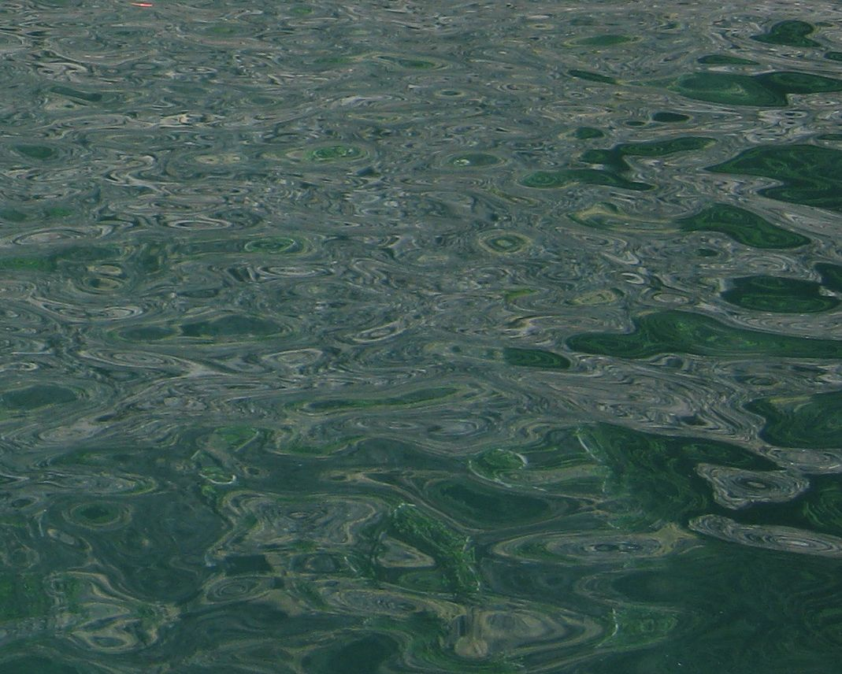
Questions?

Slide 12
